Slide 1


RESUME CLASSIFICATION
Mentor Name: Mr. Adhvaith sir
PROJECT P(145)
TEAM MEMBERS:
Ms. Mizna Majid Patel
Mr. Pratik Tushar Gade
Mr. Aditya Mahendra Gawade
Mr. Karan Dilip Sonpure
Mr. Vivek Taral
Ms. Ishika Welekar
Mrs. Aditee Samir Dhatkar.
Mr. Akash Raju Kadam

Slide 2
Problem Statements
Today the major problem being faced across the industry is how to acquire the right talent, using minimal resources over the internet and in minimal time. As described there are three major challenges that are required to be overcome, to bring efficiencies to the complete process.
• Separating the right candidates from the pack
• Making sense of candidate CVs
• Knowing that candidates can do the job before you hire them.

Slide 3
Business Objective
To Create a Resumes Parser based on Natural Language Processing to extract required information from resumes.
To make case of selection resumes for recruiter without actually going through each of them.
To help candidates to find and apply the most suitable job roles form the job.

Slide 4
PROJECT ARCHITECTURE
COLLECTION OF DATA
BUSINESS UNDERSTANDING
EXPLORATORY DATA ANALYSIS(EDA)
DEPLOYMENT
FINALIZING MODEL
MODEL SELECTION

Slide 5
import libraries
We have to first install libraries to work on the import libraries of resume classification dataset.
#!pip install python-doc
#!python -m pip install docx2txt
#!pip install textract
#!pip install python-docx
#!pip install xgboost
#!python.exe -m pip install --upgrade pip
#!pip install docs
#!python -m spacy download en_core_web_trf
#!pip install spacy-transformers

Slide 6
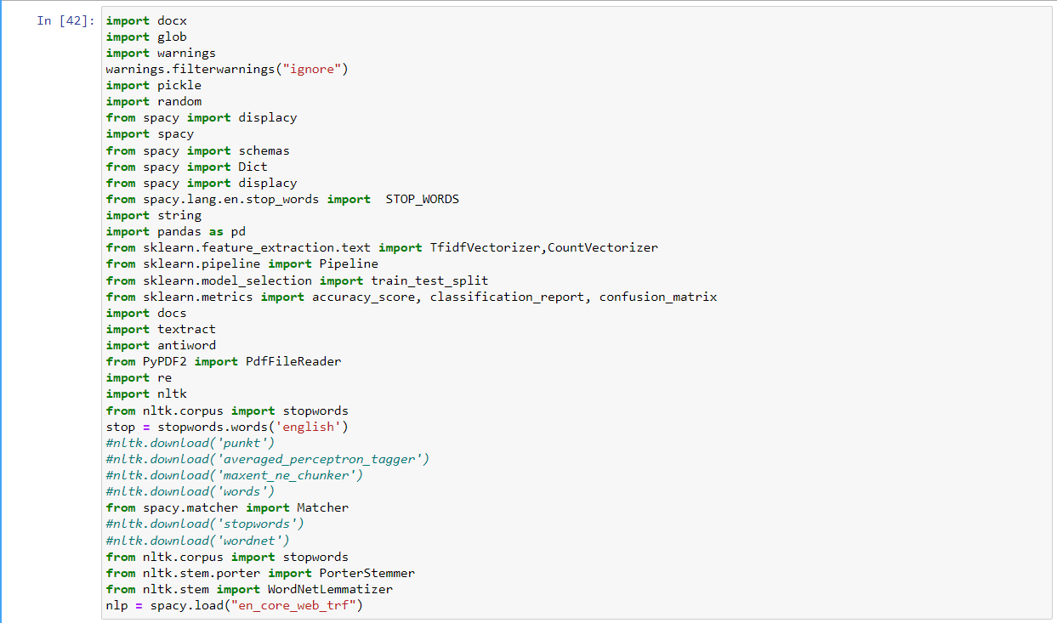
We have to import these libraries to work on the resume classification dataset.

Slide 7
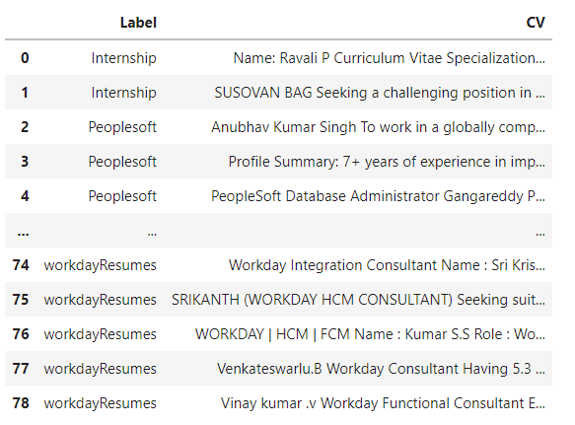
DataSet Details
After Extracting and Modifying the Dataset, given data contains a total of 2 features and 78 rows . By using features we will get the desired resume sample (person) for the software organization/Company.

Slide 8
DATA UNDERSTANDING and EDA
This dataset is all about candidate Resumes
BEFORE CLEANING RESUMES IN DATASET, There are total 3,62,913 CHARACTERS and 51,305 WORDS present in Resume i.e. ‘CV’ column in dataset.
CLEANING AND TOKENIZATION:
There is Punctuation, Uppercase Characters presents in resume . When working with Text, one of the first step is to vectorize to create a Bag of Words(BOW). This bag will hold information about individual words. Before creating BOW, the text data needs to be cleaned and tokenized. This will prevents the words with different punctuation. By removing punctuation and lowercasing everything we are creating tokens . We will do this using REGULAR EXPRESSION TOOL (REGEX).
REGEX tool allow us to filter through and pull information from a text document without having to physically read it.
REMOVAL OF STOPWORDS:
Stopwords are a set of commonly used words in any language. For example, in English, “the”, “is” and “and”, would easily qualify as stopwords.

Slide 9
Text pre-processing
In NLP, text preprocessing is the first step in the process of building a model. The various text preprocessing steps are: Tokenization, Lower casting, Stop words removal, Stemming, Lemmatization.
After cleaning whole dataset, Now total 2,95,942 characters and 36,185 words presents in Resumes.
Label Encoder
The Label Encoder is class of Sklearn library and used to convert the data and text data.
We apply Label Encoding to “Label” feature in dataset and made a separate column named as “Encoded_skill”.

Slide 10
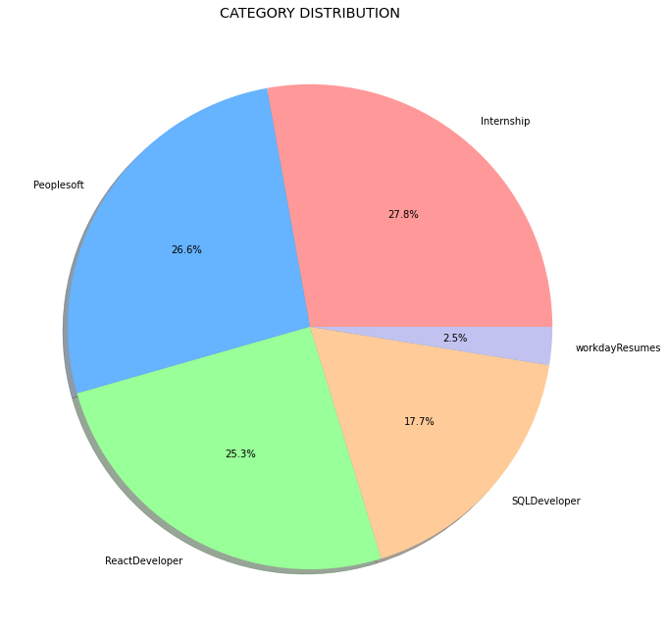
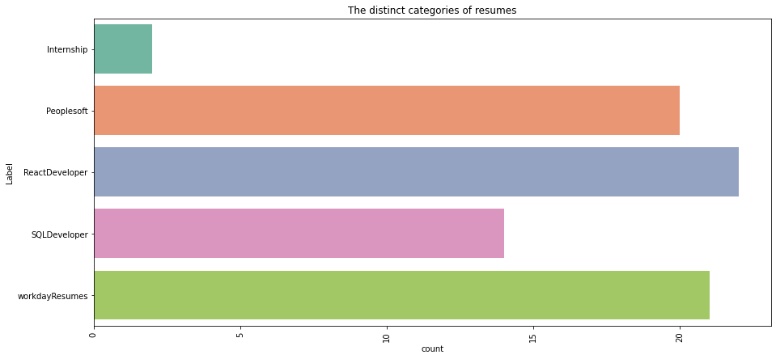
Visualization OF DATASET
By using Pie chart role applied feature is displayed to visualize the job roles.
By using Histogram role applied feature is displayed to check the job types.

Slide 11
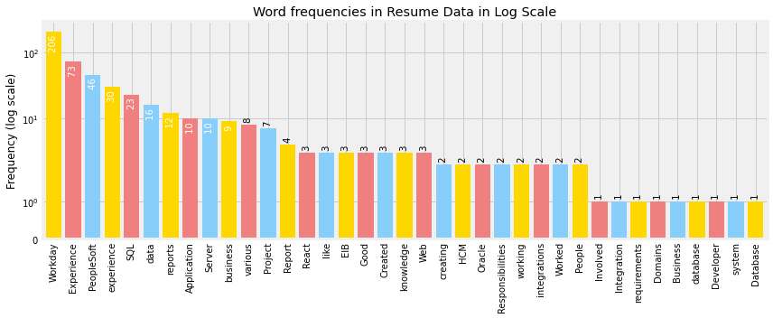
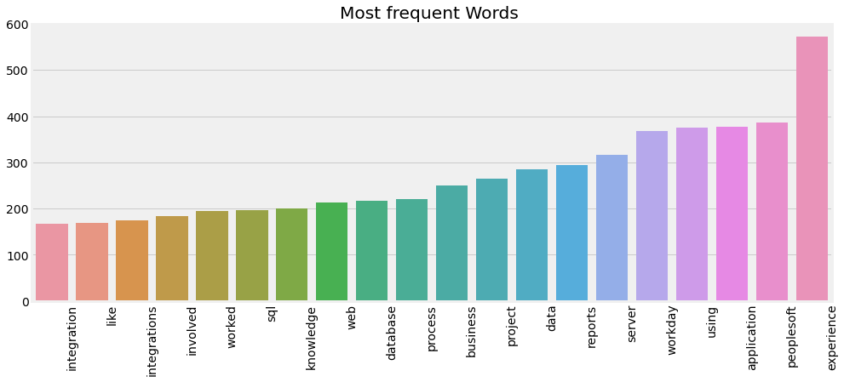
Word Frequencies in Resumes
In this graph the frequency of Words in Resumes are show, there is most of the words are highly used in the dataset like Workday, Experience, experience, peoplesoft .etc

Slide 12
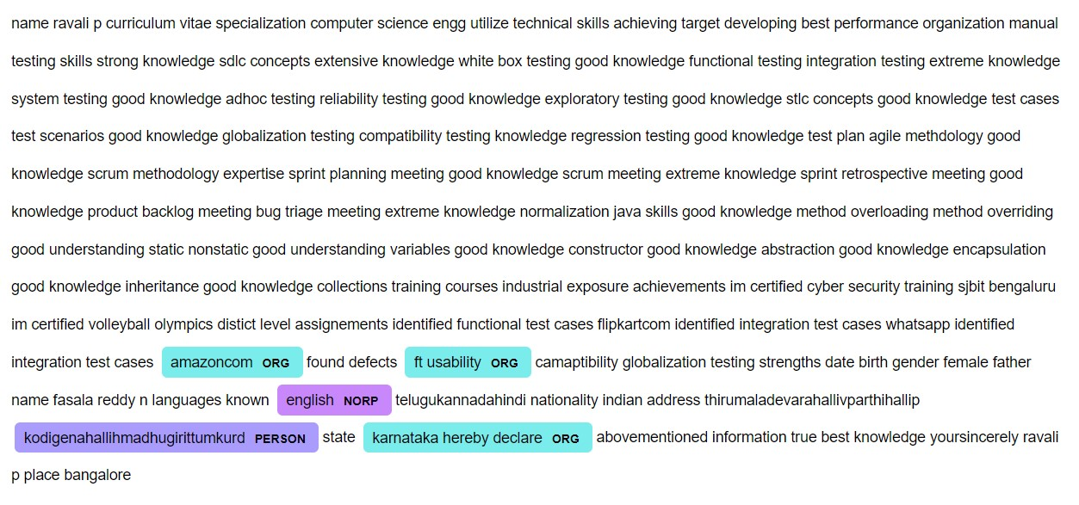
Performing A NER (Named entity recognition)(Using Spacy)

Slide 13
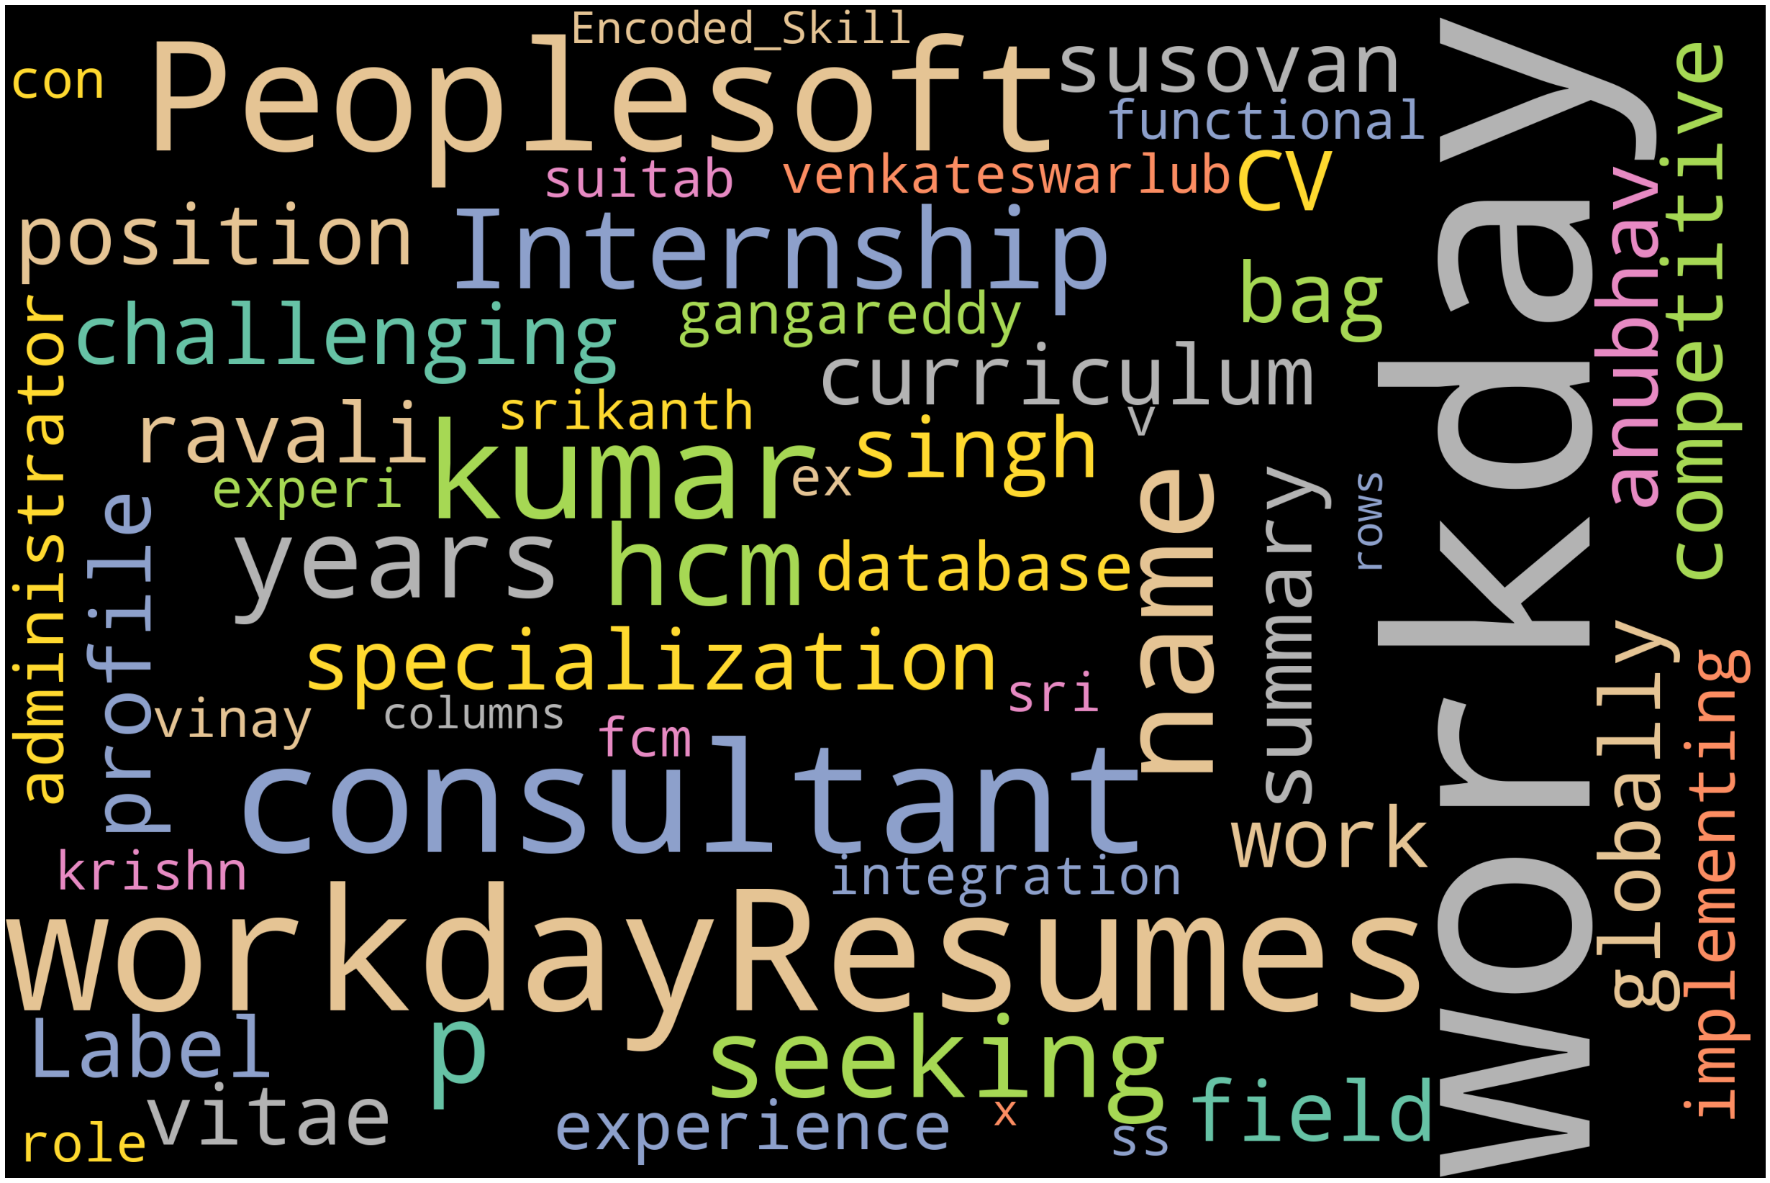
WORDCLOUD

Slide 14
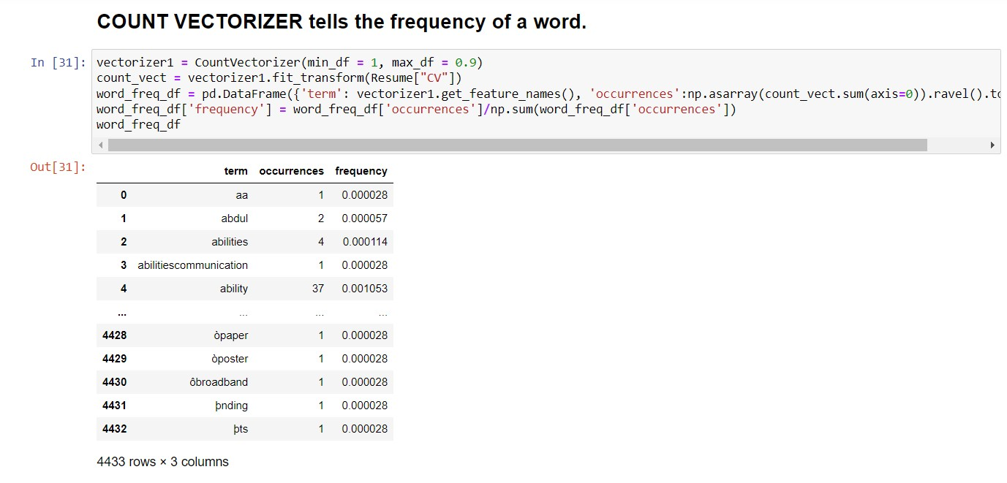
BAG OF WORDS(BOW)
A bag-of-words is a representation of text that describes the occurrence of words within a document. It involves two things: A vocabulary of known words. A measure of the presence of known words
COUNT VECTORIZATION
Scikit-learn's Count Vectorizer is used to convert a collection of text documents to a vector of term/token counts. It also enables the ​pre-processing of text data prior to generating the vector representation.

Slide 15
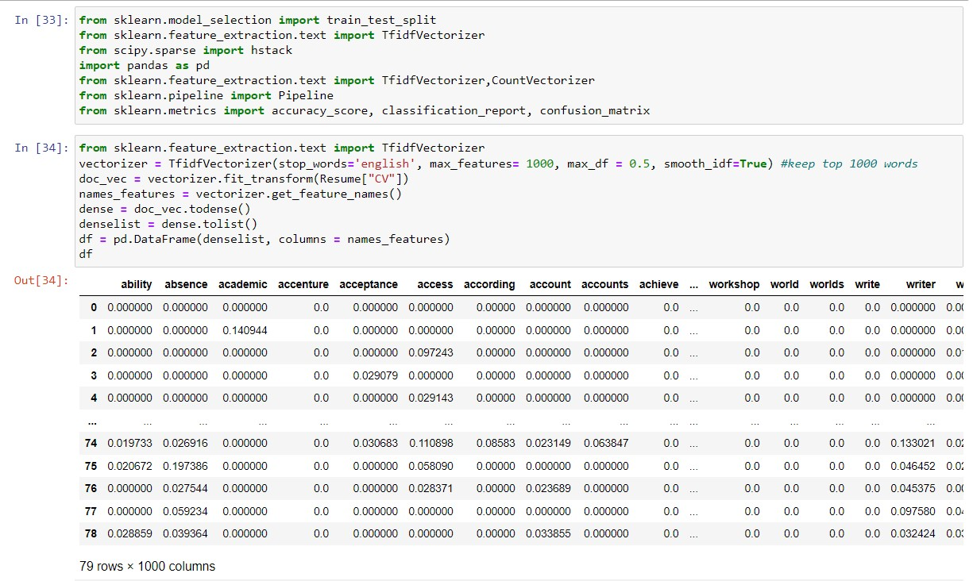
TFIDF - Term frequency inverse Document Frequency
TFIDFVectorizer transforms text to feature vectors that can be used as a input to estimator. Vocabulary is a dictionary that converts each token(word) to feature index in the matrix, each unique token gets a feature index.
TFIDF is one of the most popular text vectorizers, the calculation is very simple and easy to understand. It gives the rare term high weight and gives the common term low weight.

Slide 16
MODEL BUILDING
DATA PREPROCESSING
We have split data into two dataset: Train and Test. The ratio of splitting was 80 x 20.
The shape of train and test splitting:
SHAPE OF TRAIN DATA : 63
SHAPE OF TEST DATA : 16

Slide 17
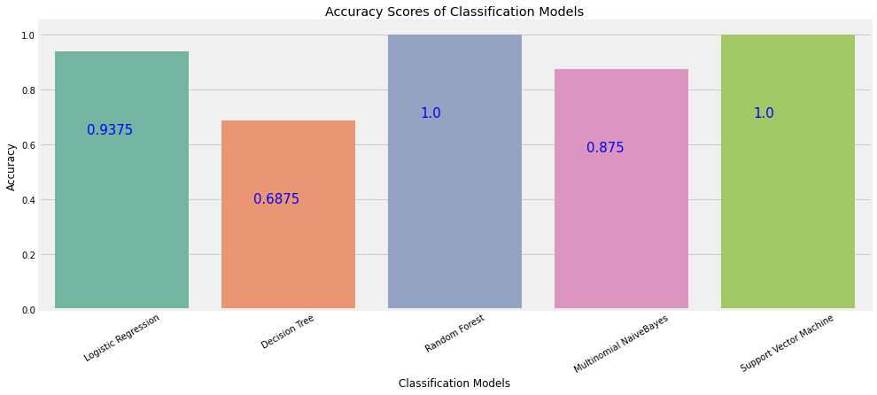
ACCURACY SCORE
We have trained and tested each model and recorded the resultant accuracy . BELOW GRAPH SHOW THE ACCURACY OF EACH CLASSIFIER
LOGISTIC REGRESSION: 93.75%
DECISION TRESS: 68.75%
RANDOM FOREST: 100%
MULTINOMIAL NAÏVE BAYES: 87.75%
SUPPORT VECTOR MACHINE: 100%

Slide 18
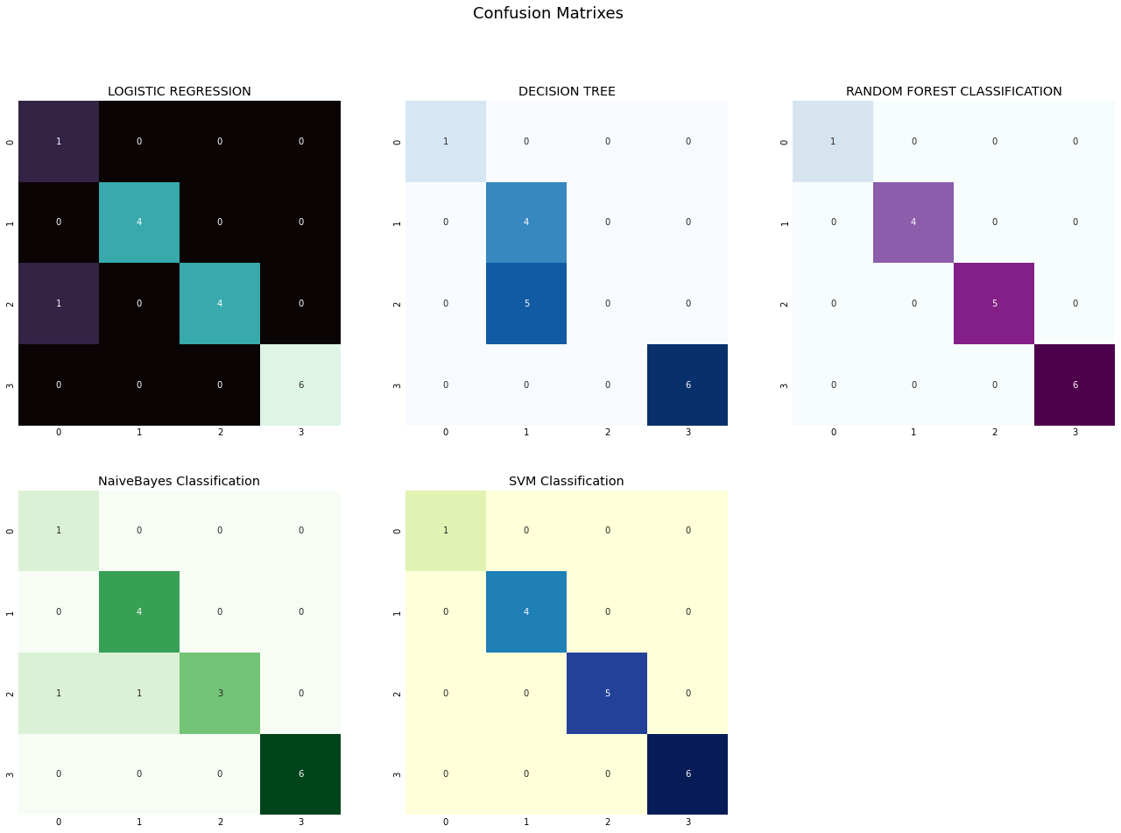
CONFUSION MATRIX
CONFUSION MATRIX visualizes and summarizes the performance of a classification algorithm. It gives information about errors made by the classifier and the types of errors that are being made . It reflects how a classification model is disorganized and confused while making predictions.

Slide 19
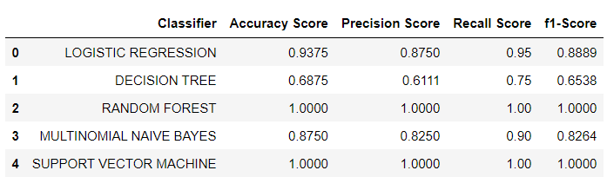
CLASSIFICATION REPORT
SHORT AND QUICK EXPLAINATION ABOUT ACCURACY, PRECISION, RECALL, F1_SCORE:
Accuracy tells us how many times the model was correct
Precision is how good the model is at predicting a specific category
Recall tells us how many times the model was able to detect a specific category
F1_score is combines the precision and recall of a classifier into a single metric by taking their harmonic mean

Slide 20
Finalizing model from the accuracy , precision, recall,F1_score comparison, we got 100% result in random forest classifier and support vector classifier.

Slide 21
DEPLOYMENT
After model building and Evaluation process, We have deployed the code using “ Streamlit ”.
We have selected the best model RANDOM FOREST CLASSIFIER and used in our deployment phase

Slide 22
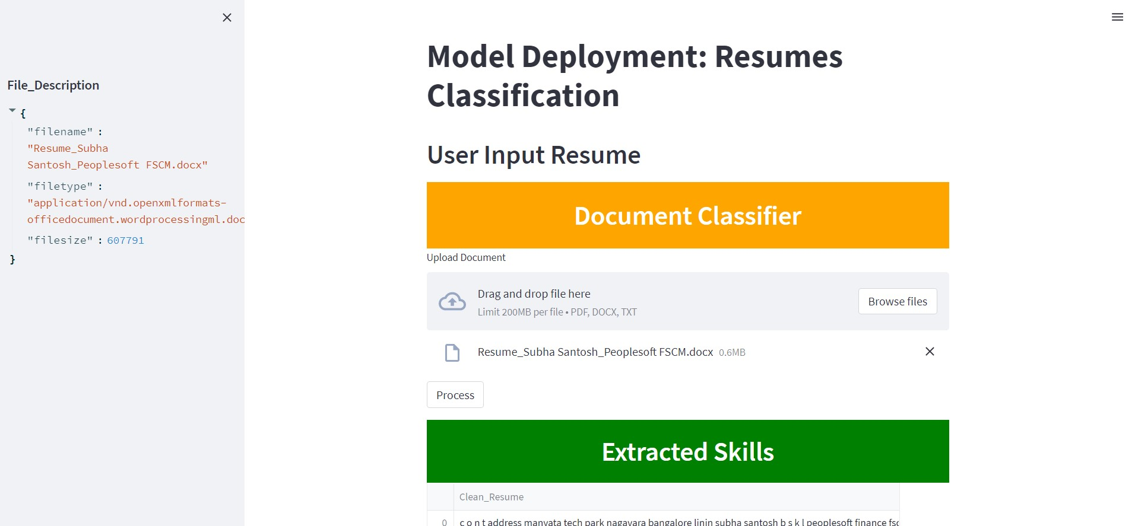
DEPLOYMENT

Slide 23
CONCLUSION
The concept of classification is grasped by Resume Classification, and classification models have been built using numerous techniques. This resume categorization platform will make the e-recruitment process more efficient and user-friendly. This approach will assist businesses and save time throughout the recruitment process.

Slide 24
THANK YOU

